Slide 1
CEN 3078 Computer Security
Module 1 – Application and Network Analysis

Slide 2
Network and application layers – security concepts
Packet sniffing and spoofing
Intrusion detection systems
Legal and ethical issues
Module 1

Slide 3
Network and application layers – security concepts
Packet sniffing and spoofing
Intrusion detection systems
Legal and ethical issues
Module 1

Slide 4
Model of Internet Layers for User/Device Communications

Slide 5
TCP/IP Communication

Slide 6
TCP/IP Communication (2)

Slide 7
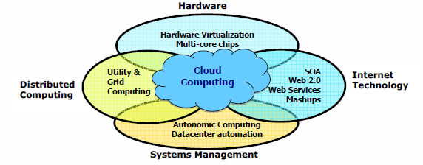
Diverse Computing and Data Deluge Enabling New Cybersecurity Challenges

Slide 8
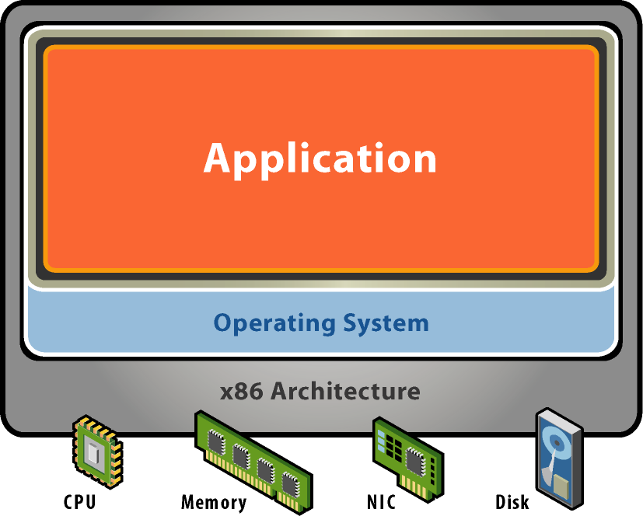
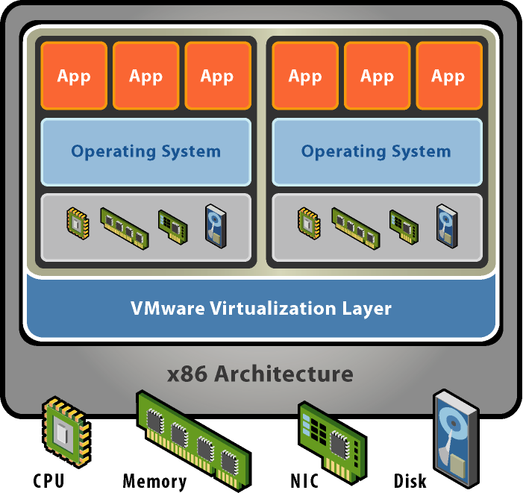
Virtual Machines in Today’s Computing
Without Virtualization
With Virtualization
Notes:
Hardware-independence of operating system and applications
VMs can be provisioned to any system
Can manage OS and application as a single unit by encapsulating them into VMs
Virtual machines are not a new concept. They were developed over thirty years ago for mainframe systems to allow multiple users to safely share those expensive machines. As computers became cheaper, the motivation behind virtualization faded and processor architectures like the Intel x86 were developed without some of the features needed to support virtualization.
VMware’s founders resurrected the virtual machine concept when problems like server proliferation and the need to run multiple applications in dedicated operating systems started becoming serious issues for IT managers and software developers. VMware developed revolutionary technology to efficiently virtualize x86 systems that,for the first time, allowed unmodified x86 operating systems and applications to run in true virtual machines with excellent performance.
Multiple virtual machines can operate concurrently on a single x86 host system. Each one can run a different operating system and application stack.
VMware’s virtualization technology provides each virtual machine with a true representation of an x86 computer, complete with processor, memory, networking interfaces and storage devices. The VMware virtualization layer gives the virtual machines direct access to the underlying x86 hardware – an important distinction from the much slower emulation technology that must process all virtual machine operations in software.

Slide 9
Identifying Types of Threats
Malware: MALicious softWARE
Security breaches
DoS: Denial of Service attacks
Web attacks
Session hijacking
Insider threats
DNS poisoning
New attacks: Doxing

Slide 10
Malware
Software with a malicious purpose
Viruses
Trojan horses
Spyware
Logic bombs

Slide 11
Malware (cont.)
Viruses
One of the two most common types of malware
Designed to replicate and spread
Usually spreads through email
Uses system resources, causing network slowdowns or stoppage

Slide 12
Malware (cont.)
Trojan Horses
The other most common type of malware
Named after the wooden horse of ancient history
Appears benign but secretly downloads malware onto a computer from within

Slide 13
Malware (cont.)
Spyware
A rapidly growing type of malware
Cookies
Key loggers
Logic Bombs
Lay dormant until some logical condition is met, often a specific date

Slide 14
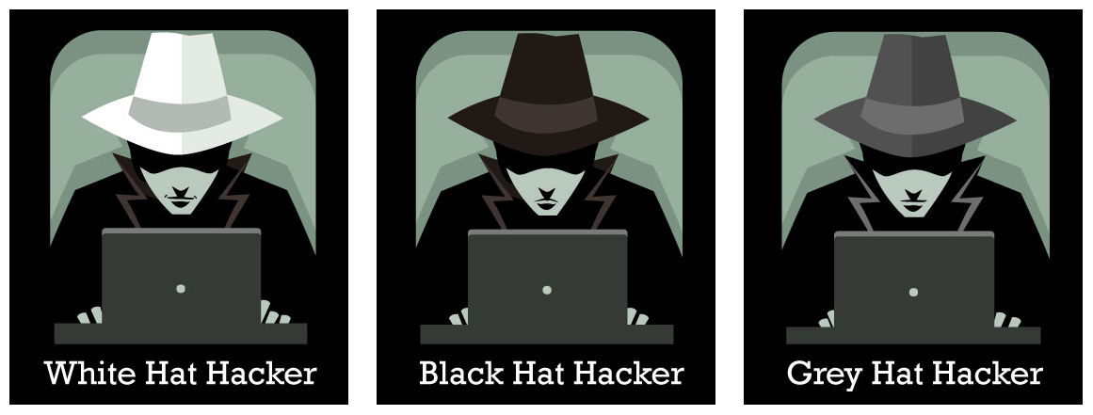
Types of Ethical Hackers
White Hat Hacker
Do not intend to harm the system or organization but they so, officially to penetrate and locate the vulnerabilities, providing to fix them and ensure safety
Black Hat Hacker
They are non-ethical hackers performing hacking to fulfill their selfish intentions to collect monetary benefits
Grey Hat Hacker
Combination of white and black – they hack without any malicious intent for fun; don’t use approval from a targeted organization and publicly disclose any vulnerability

Slide 15
Basic Security Terminology
Devices:
Firewall
Filters network traffic
Proxy server
Disguises IP address of internal host
Intrusion Detection System (IDS)
Monitors traffic, looking for attempted attacks
Activities:
Authentication
Auditing

Slide 16
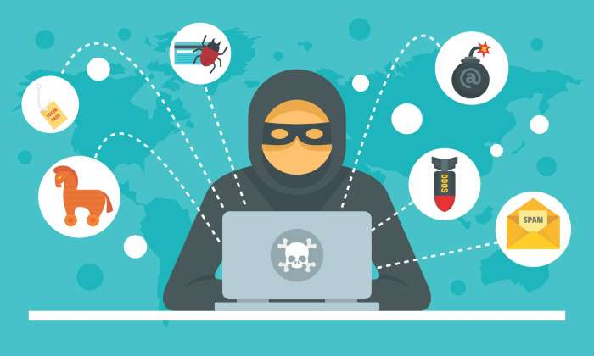
Exercise: Act during an Intrusion
Suppose you observe that your PC is responding very slowly to information requests from the net. And then you further observe that your network gateway shows high levels of network activity, even though you have closed your e-mail client, Web browser, and other programs that access the net.
What types of malware could cause these symptoms?
How might the malware have gained access to your system?
What steps can you take to check whether this has occurred?
If you do identify malware on your PC, how can you restore it to safe operation?

Slide 17
In-Class Exercise: Act during an Intrusion
What types of malware could cause these symptoms?
Virus, Worm
How might the malware have gained access to your system?
Phishing attacks using malicious email messages that activate the virus or worms by using a web link pointing to a malware download or carrying malicious attachments
What steps can you take to check whether this has occurred?
Refer to your anti-virus software logs
Use a traffic network analyzer, like Wireshark, and scan the network traffic for a period of time to possibly determine the type of traffic being generated by the PC, the destination, and also the service that is generating that traffic

Slide 18
In-Class Exercise: Act during an Intrusion
d) If you do identify malware on your PC, how can you restore it to safe operation?
Isolate the machine from any network connections
Attempt to create a backup of the data, although the backup will contain infected files, at least data will be saved for future cleaning
If possible, completely rebuild the system and recover the data from the most recent backup that is considered free from malware
If no backups are available then try to clean the system using an anti-virus package or other data recovery tools
Moral: Have a plan and know your Risks; Consider Cyber Insurance purchase and follow Incident Response best practices…

Slide 19
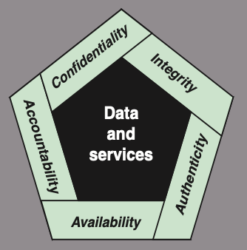
Cyber Security Definition
NIST 7298 Report defines the term cybersecurity as follows:
“Measures and controls that ensure confidentiality, integrity, and availability of information system assets including hardware, software, firmware, and information being processed, stored, and communicated.”
1. What assets do we need to protect?
2. How are those assets threatened?
3. What can we do to counter those threats?
NIST standard FIPS 199 (Standards for Security Categorization of Federal Information and Information Systems)

Slide 20
Key Security Concepts
Confidentiality
Integrity
Availability
Preserving authorized restrictions on information access and disclosure, including means for protecting personal privacy and proprietary information
Loss of confidentiality is the unauthorized disclosure of
information
Guarding against improper information modification or destruction, including ensuring information nonrepudiation and authenticity
Loss of integrity is the unauthorized modification or destruction of information
Ensuring timely and reliable access to and use of information
Loss of availability is the disruption of access to or use of information or an information system

Slide 21
Related CIA Triad Definitions – from Information Assurance Perspective
Confidentiality: This term covers two related concepts:
Data confidentiality: Assures that private or confidential information is not made available or disclosed to unauthorized individuals
Privacy: Assures that individuals control or influence what information related to them may be collected and stored and by whom and to whom that information may be disclosed
Integrity: This term covers two related concepts:
Data integrity: Assures that information and programs are changed only in a specified and authorized manner
System integrity: Assures that a system performs its intended function in an unimpaired manner, free from deliberate or inadvertent unauthorized manipulation of the system
Availability: Assures that systems work promptly and service is not denied to authorized users
Notes:
CREATE A STORY OF A PERSON WHOSE EMAIL IS HACKED, THEN TWITTER IS HACKED WITH REPULSIVE MESSAGES, FACEBOOK FRIENDS BLOCKED, AND THEN BANK INFO IS CHANGED AND THEN EMAIL ACCESS IS DENIED – WRITE ALL DEFINITIONS ON BOARD AND STRIKE OUT TERMS E.G., ADVERSARY, THREAT, ATTACK, ETC.

Slide 22
Application Security vs. Network Security
Application Security
Preservation of confidentiality, integrity, and availability of application information
Other properties such as authenticity, accountability, non-repudiation, and reliability can also be involved
Network Security
Protection of networks and their services from unauthorized modification, destruction, or disclosure
Provision of assurance that the network performs its critical function correctly and that there are no harmful side effects

Slide 23
Other Essential Definitions
Authenticity: The property of being genuine and being able to be verified and trusted; confidence in the validity of a transmission, a message, or message originator
This means verifying that users are who they say they are and that each input arriving at the system came from a trusted source
Non-Repudiation: Assurance that the sender of information is provided with proof of delivery and the recipient is provided with proof of the sender’s identity, so neither can later deny having processed the information (e.g., digital signatures that help one to not deny validity)
Accountability: The security goal that generates the requirement for actions of an entity to be traced uniquely to that entity
This supports non-repudiation, deterrence, fault isolation, intrusion detection and prevention, and after-action recovery and legal action
Because truly secure systems are not yet an achievable goal, we must be able to trace a security breach to a responsible party
Systems must keep records of their activities to permit later forensic analysis to trace security breaches or to aid in transaction disputes

Slide 24
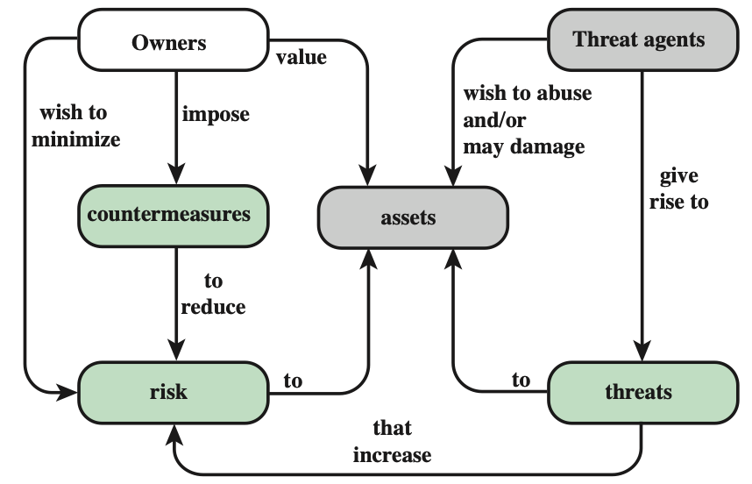
Security Concepts and Relationships (from RFC 2828, Internet Security Glossary)

Slide 25
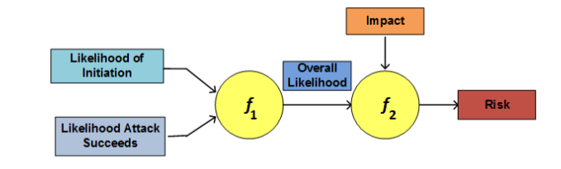
Security Concepts and Relationships (from RFC 2828, Internet Security Glossary)
Adversary (threat agent)
Individual, group, organization, or government that conducts or has the intent to conduct detrimental activities
Attack
Any kind of malicious activity that attempts to collect, disrupt, deny, degrade, or destroy information system resources or the information itself
Countermeasure
A device or techniques that has as its objective the impairment of the operational effectiveness of undesirable or adversarial activity
Aims to prevent espionage, sabotage, theft, or unauthorized access to or use of sensitive information or information systems
Risk
A measure of the extent to which an entity is threatened by a potential circumstance or event, and typically a function of: (i) the adverse impacts that would arise if the circumstance or event occurs; and (ii) the likelihood of occurrence

Slide 26
Security Concepts and Relationships (2) (from RFC 2828, Internet Security Glossary)
Security Policy
A set of criteria for the provision of security services; It defines and constrains the activities of a data processing facility in order to maintain a condition of security for systems and data.
System Resource (Asset – Hardware, Software, Data, Network)
A major application, general support system, high impact program, physical plant, mission critical system, personnel, equipment, or a logically related group of systems
Threat
Any circumstance or event with the potential to adversely impact/harm: organizational operations (including mission, functions, image, or reputation), organizational assets, individuals, other organizations, or the Nation through an information system – via unauthorized access, destruction, disclosure, modification of information, and/or denial of service
Vulnerability
Flaw or weakness within: an information system, system security procedures, internal controls, or implementation that could be exploited or triggered by a threat source
Basically, a threat is a possible danger that might exploit a vulnerability…

Slide 27
Vulnerabilities, Threats and Attacks
Categories of vulnerabilities
Corrupted (loss of integrity)
Leaky (loss of confidentiality)
Unavailable or very slow (loss of availability)
Threats
Capable of exploiting vulnerabilities
Represent potential security harm to an asset
Attacks (threats carried out)
Passive – attempt to learn or make use of information from the system that does not affect system resources
Active – attempt to alter system resources or affect their operation
Insider – initiated by an entity inside the security parameter
Outsider – initiated from outside the perimeter

Slide 28
Levels of Impact
Low
The loss could be expected to have a limited adverse effect on organizational operations, organizational assets, or individuals
Moderate
The loss could be expected to have a serious adverse effect on organizational operations, organizational assets, or individuals
High
The loss could be expected to have a severe or catastrophic adverse effect on organizational operations, organizational assets, or individuals
(i) organization functions are noticeably reduced; (ii) minor damage to assets; (iii) minor financial loss; or (iv) minor harm to individuals
(i) organization functions are significantly reduced; (ii) significant assets damage; (iii) significant financial loss; or (iv) significant but not life-threatening individuals harm
(i) organization functions are severely disrupted; (ii) major damage to assets; (iii) catastrophic financial loss; or (iv) individual loss of life or life-threatening injuries

Slide 29
Some Survey Findings…
The chief impediment to implementing cloud services was security, listed by 85% of federal IT managers
Source: MeriTalk Cloud Computing Exchange
67% of IT professionals say their organization is very vulnerable because cloud ports and firewalls are not adequately secured
Source: Ponemon Institute
“…human factors, is the biggest contributor responsible for 50 to 80 percent of network device outages”
Source: Juniper Networks Whitepaper

Slide 30
In-Class Exercise: How to Secure Linux OS?
To avoid malicious compromise of system resources, following issues need to be addressed:
Use strong passwords – lock account if multiple login failures
Install only the required software packages
Do you need Apache?
Setup access lists for services (i.e., host firewall)
Regularly patch the OS
Check listening ports and verify if those are required
Use “netstat” or even an Intrusion Detection System (IDS) for monitoring
Run only required system services
Use “chkconfig” to list all services started at bootup
Avoid telnet, rlogin and rsh – use scp/sftp instead
Secure remote access
Secure NFS if sharing files over network
For more details - http://www.puschitz.com/SecuringLinux.shtml

Slide 31
Online Security Resources
CERT
www.cert.org
Microsoft Security Response Center
https://www.microsoft.com/en-us/msrc?rtc=1
F-Secure
www.f-secure.com
SANS
www.sans.org

Slide 32
Certification List
(One letter grade) Certificate of Cloud Security Knowledge (CCSK) https://cloudsecurityalliance.org/education/ccsk/
(Two letter grade) ISC2 Certified Cloud Security Professional (CCSP) https://www.isc2.org/certifications/ccsp
(One letter grade) ISC2 Certified in Cybersecurity (CC) https://www.isc2.org/certifications/cc
(Two letter grade) ISC2 Systems Security Certified Practitioner (SSCP) https://www.isc2.org/certifications/sscp
(Two letter grade) CompTIA Security+ https://www.comptia.org/certifications/security

Slide 33
Threats on Assets
An online drive is compromised
After a successful attack (e.g., Sony Hack)
An unauthorized copy of software is made - or -
Licenses are used without permission

Slide 34
Importance of Cybersecurity for Manufacturers
Manufacturing businesses are increasing online for operations
Web, Cloud Computing, Internet-of-Things, Big Data
Manufacturers are unfortunately a frequent target of hackers and attackers
According to a report from the U.S. Department for Homeland Security, manufacturing is the second highest industry with the most reported cyber attacks, only subsequent to the energy sector
According to a report by NTT Security, the manufacturing industry was the most heavily targeted industry during Q2 2017, accounting for 34% of all documented attack activity
A Kaspersky Lab Survey of IT managers published in Virus News also found that “21 percent of manufacturers suffered a loss of intellectual property (IP) within the past year”
https://www.nist.gov/blogs/manufacturing-innovation-blog/cybersecurity-protecting-manufacturing-technology-and-innovation

Slide 35
In-Class Exercise: Create a survey for a small-business company
Create a survey questionnaire that will help a cybersecurity expert to assist a manufacturing/utility enterprise in becoming aware of their current cyber security posture and help them in:
Defending their company’s vital data and information
Preventing theft or damage to company infrastructure, equipment and systems
Avoiding major disruptions to operations and the delivery of products
Protecting employee’s personal information
Shielding the company from negative publicity
Planning IT budgets and policies with adequate cyber incident response
Discuss potential improvements in cyber attack threat detection and mitigation strategies that result in benefits in terms of:
increased productivity, cost savings and reduced risk

Slide 36
Small Business Response Exercise
Assume you are speaking to a small business enterprise
- <<Name>>
Q1) Important assets in your enterprise that are networked internally or with an external site
a) Do you use industrial equipment that is connected to the Internet? Yes / No
b) Are there machines connected to computers with industry-standard/paid software licenses? Yes / No
c) Do you store and share business-related data using cloud platforms? Yes / No
d) Do you operate a private data center/server with network equipment? Yes / No
e) Briefly describe any other relevant information pertaining to Q1:

Slide 37
Small Business Response Exercise (2)
Q2) Potential cyber attack threats and the risks associated with compromise of valuable assets
a) Are you concerned about loss of data confidentiality due to undesired information exposure? Yes / No
b) Are you concerned about data integrity because of data corruption by human/machine? Yes / No
c) Are you concerned of loss of services or infrastructure that makes data inaccessible? Yes / No
d) Briefly describe any other relevant information pertaining to Q2:

Slide 38
Small Business Response Exercise (3)
Q3) Solutions adopted to address cyber security threats and the risks associated with compromise of valuable assets
a) Do you use commercial or open-source software or network appliances for cyber security? Yes / No
b) Do you manage network firewalls or role-based access control policies? Yes / No
c) Do you have a process to monitor and prevent potential cyber intrusion detection? Yes / No
d) Do you need the cyber security solutions to be compliant for external security audits? Yes / No
e) Briefly describe any other relevant information pertaining to Q3:

Slide 39
Small Business Response Exercise (4)
Q4) Cyber security posture and potential of impact limits your workers day-to-day productivity
a) Do you have a cyber security posture related design document? Yes / No
b) Do you have a budget allocated for cyber security related business cost? Yes / No
c) Are you satisfied with the effort and/or $$ on cyber security? Yes / No
d) Briefly describe any other relevant information pertaining to Q4:

Slide 40
Cybersecurity Challenges
Cybersecurity is not as simple as it might first appear to the novice
Self-explanatory one-word labels: confidentiality, authentication, nonrepudiation, and integrity; BUT mechanisms to meet those requirements can be quite complex, and understanding them may involve rather subtle reasoning
In developing a particular security mechanism or algorithm, one must always consider potential attacks on those security features
In many cases, successful attacks are designed by looking at the problem in a completely different way, therefore exploiting an unexpected weakness in the mechanism
Procedures to provide security mechanism are driven by user requirements
Typically, a security mechanism complexity depends on user requirements; greater the impact of threats, greater is the need for elaborate security mechanisms
Notes:
For 2., say Winston Churchill Story – how he became famous

Slide 41
Cybersecurity Challenges (2)
Physical and logical placement of security mechanisms needs to be determined
Physical placement (e.g., at what points in a network are certain security mechanisms needed)
Logical placement (e.g., at what layer or layers of an architecture such as TCP/IP should mechanisms be placed)
Security mechanisms typically involve more than a particular algorithm or protocol and also require that participants be in possession of some secret information which raises questions about the creation, distribution, and protection of that secret information
There may also be a reliance on communications protocols whose behavior may complicate the task of developing the security mechanism
For example, if the proper functioning of the security mechanism requires setting time limits on the transit time of a message from sender to receiver, then any protocol or network that introduces variable, unpredictable delays may render such time limits meaningless

Slide 42
Cybersecurity Challenges (3)
Attackers only need to find a single weakness, while the designer must find and eliminate all weaknesses to achieve perfect security
It is a battle of wits between a perpetrator who tries to find holes, and the designer or administrator who tries to close them
Security is still too often an afterthought to be incorporated into a system after the design is complete, rather than being an integral part of the design process
There is a natural tendency on the part of users and system managers to perceive little benefit from security investment until a security failure occurs
Users view strong security as an impediment to efficient and user-friendly operation of an information system or use of information
Security requires regular and constant monitoring
What to monitor – raw or aggregate, How much to monitor – metrics, How frequent – sampling rates?

Slide 43
Network and application layers – security concepts
Packet sniffing and spoofing
Intrusion detection systems
Legal and ethical issues
Module 1

Slide 44
Passive and Active Attacks
Passive Attack
Active Attack
Attempts to learn or make use of information from the system but does not affect system resources
Hard to detect (no alteration)
Easy to stop
Eavesdropping on, or monitoring of, transmissions
Goal of attacker is to obtain information that is being transmitted
Two types:
Release of message contents
Traffic analysis
Attempts to alter system resources or affect their operation
Hard to stop
Easy to detect (application impact)
Involve some modification of the data stream or the creation of a false stream
Four categories:
Replay
Masquerade
Modification of messages
Denial of service

Slide 45
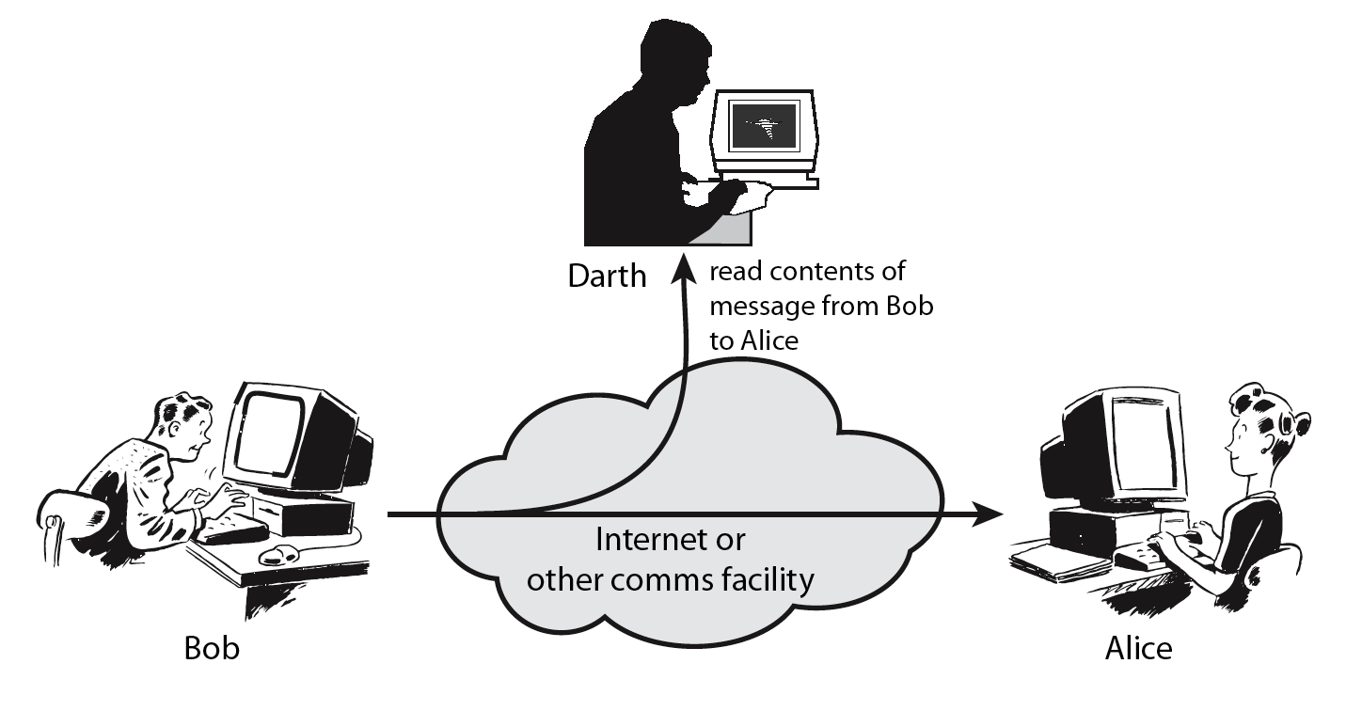
Passive Attack – Interception (Sniffing)
Packet sniffing describes the process of capturing live data as they flow across a network

Slide 46
Passive Attack – Traffic Analysis (Sniffing)
Observe traffic pattern

Slide 47
Active Attack – Interruption (Spoofing)
Packet spoofing occurs when critical information in the packet is forged by an attacker
Block delivery of message

Slide 48
Active Attack – Fabrication (Spoofing)
E.g., TCP session hijacking, DNS cache poisoning
Fabricate message

Slide 49
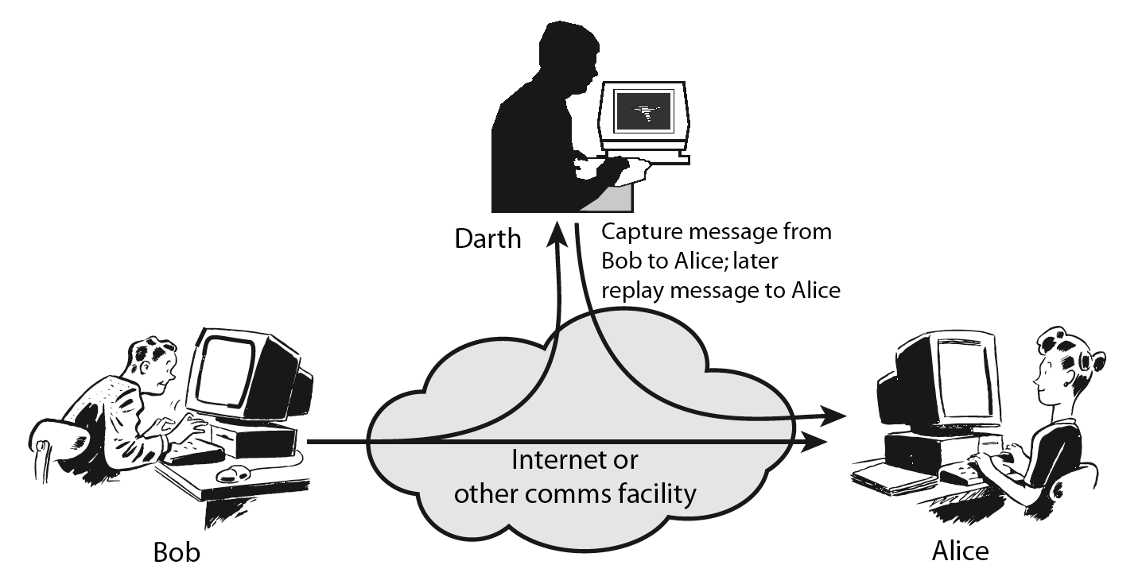
Active Attack – Replay (Sniffing + Spoofing)

Slide 50
Active Attack – Modification (Sniffing + Spoofing)
Modify message

Slide 51
TCP/IP Communication (Recall)

Slide 52
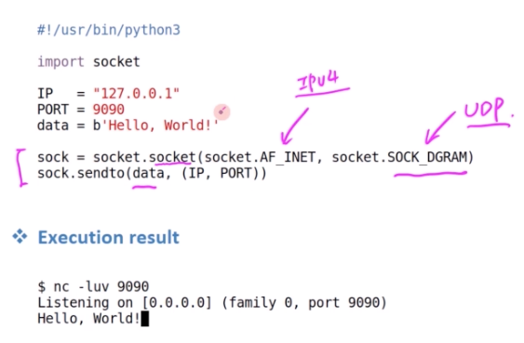
Socket Programming – Sending packets
TCP – connection-oriented transport protocol (error-free)
UDP – connectionless transport protocol (for time-sensitive communication)
Port Number – Route information to particular application process (some numbers are reserved e.g., port 80 for web servers)
UDP Client Example – sending packets using Python; and use Netcat program to test the server

Slide 53
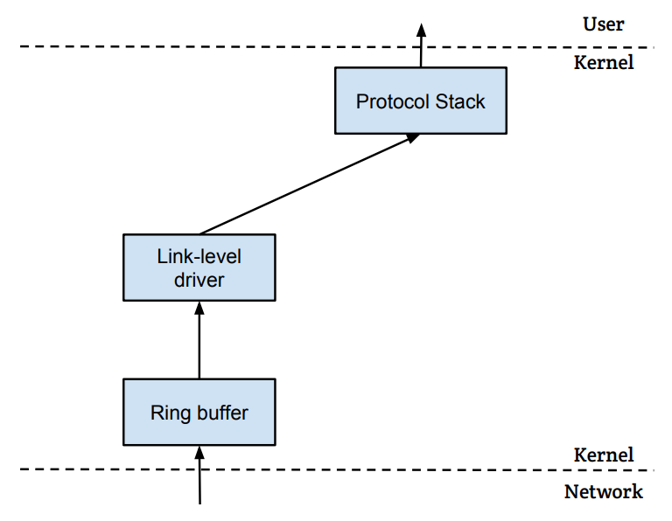
How packets are received?
NIC (Network Interface Card) is a physical or logical link between a machine and a network
Each NIC has a MAC address
Every NIC on the network will hear all the frames on the wire
NIC checks the destination address for every packet, if the address matches the card’s MAC address, it is further copied into a buffer in the kernel
Application
Upper layer processing starting with IP
Socket System Calls
OS control starts
NIC
LAN (Layer 2)

Slide 54
Sniffing and Spoofing - Related Concepts
Promiscuous Mode - NIC passes every frame received from the network to the kernel; requires root or other elevated privilege to enable
Raw Sockets – a special type of socket that allows a sniffing program to capture all packets flowing on the network cable, regardless of destination IP address or port number; used to implement spoofing
BSD Packet Filter (BPF) – Unix utility for packet filtering at the lower level; a user space program to attach a filter to a socket; Kernel can be made to discard unwanted packets as early as possible by setting filters at different places along a captured packet’s traverse path
pcap API – a packet capture API used to implement sniffing using a platform independent interface – allows portable access to operating system’s packet capture facility; libpcap in Unix (from TCPdump) and WinPcap in Windows
Wireshark tool is popular to capture packets and examine contents (without coding)
Scapy – built on top of libpcap; commonly used for productivity (for performance purposes, better to use C); Hybrid Approach also works where Scapy is used to construct packets, and use C to slightly modify packets and then send packets
Use Scapy for coding packet manipulations: packet parsing, packet sending and receiving, packet sniffing, packet spoofing, adding new protocols, etc.

Slide 55
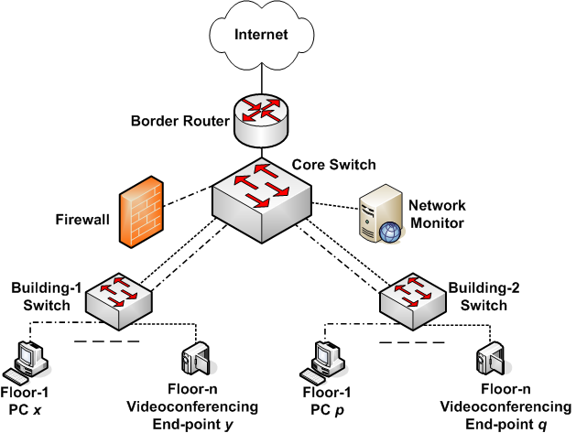
Honey Pot - Sniffing
Hacker Story -Kevin Mitnick with SDSC
Snort, Mysql

Slide 56
Attack Surfaces
Consist of the reachable and exploitable vulnerabilities in a system
Examples:
Open ports on outward facing Web and other servers, and code listening on those ports
Services available on the inside of a firewall
Code that processes incoming data, email, XML, office documents, and industry-specific custom data exchange formats
Interfaces, SQL, and Web forms
An employee with access to sensitive information vulnerable to a social engineering attack

Slide 57
Attack Surface Categories
Network Attack Surface
Vulnerabilities over an enterprise network, wide-area network, or the Internet
Network protocol vulnerabilities, such as those used for a DoS attack, disruption of communications links
Software Attack Surface
Vulnerabilities in application, utility, or operating system code
Particular focus is Web server software
Human Attack Surface
Vulnerabilities created by personnel or outsiders, such as social engineering, human error, and trusted insiders

Slide 58
Attack Surface Analysis
An attack surface analysis is a useful technique for assessing the scale and severity of threats to a system
A systematic analysis of points of vulnerability makes developers and security analysts aware of where security mechanisms are required
Use Decomposition to document components, applications and their infrastructure → develop data flow diagrams along with privilege boundaries → ensure proper controls are in place for any data crossing boundaries
Once an attack surface is defined, designers may be able to find ways to make the surface smaller, thus making the task of the adversary more difficult
Ignore “high-risk, low-reward” cases
The attack surface also provides guidance on setting priorities for testing, strengthening security measures, or modifying the service or application
Determine the layers of security you need based on the threat, don’t forget they impact performance

Slide 59



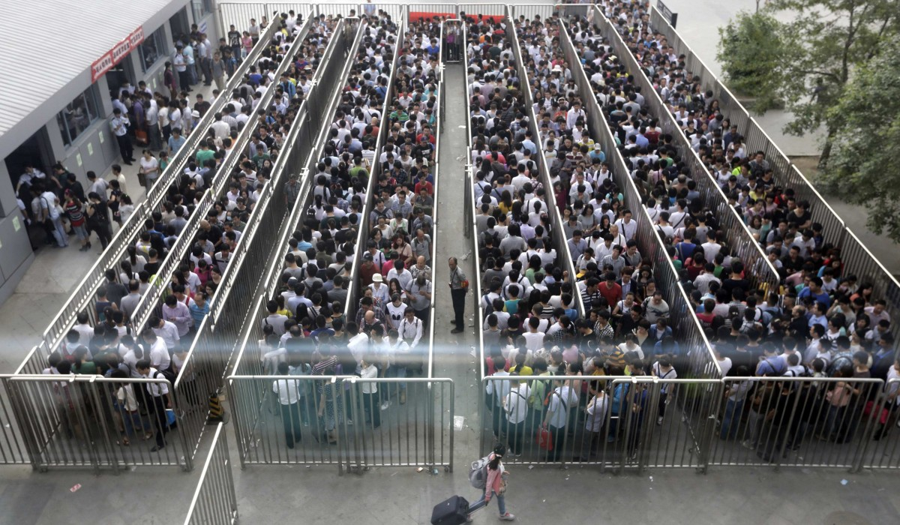
Applying all possible security tools strengths security at expense of the performance
By 2020, $101.6 billion will be spent in cyber security, to build high walls and deep moats
http://fortune.com/2016/10/12/cybersecurity-global-spending/
High Walls
Deep Moats
Invincible Army
Long Access…
There is need to bridge the gaps in the information management and security/compliance needs, while also maintaining satisfactory application performance…

Slide 60
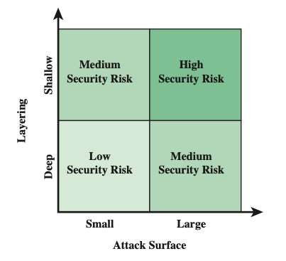
Attack Surface and Defense Depth

Slide 61
Attacks in a Cloud Computing Environment
Three actors involved; six types of attacks possible
The user can be attacked by:
Service → SSL certificate spoofing, attacks on browser caches, or phishing attacks
The cloud infrastructure → attacks that either originates at the cloud or spoofs to originate from the cloud infrastructure
The service can be attacked by:
A user → buffer overflow, SQL injection, and privilege escalation are the common types of attacks
The cloud infrastructure → the most serious line of attack; Limiting access to resources, privilege-related attacks, data distortion, injecting additional operations
The cloud infrastructure can be attacked by:
A user → targets the cloud control system
A service → requesting an excessive amount of resources and causing the exhaustion of the resources

Slide 62
Threat Modeling
Threat model - a framework which details internal and external vulnerabilities, as well as objectives and countermeasures
Five major threat modeling steps:
Defining security requirements
Creating an application diagram
Identifying threats
Mitigating threats
Validating that threats have been mitigated

Slide 63
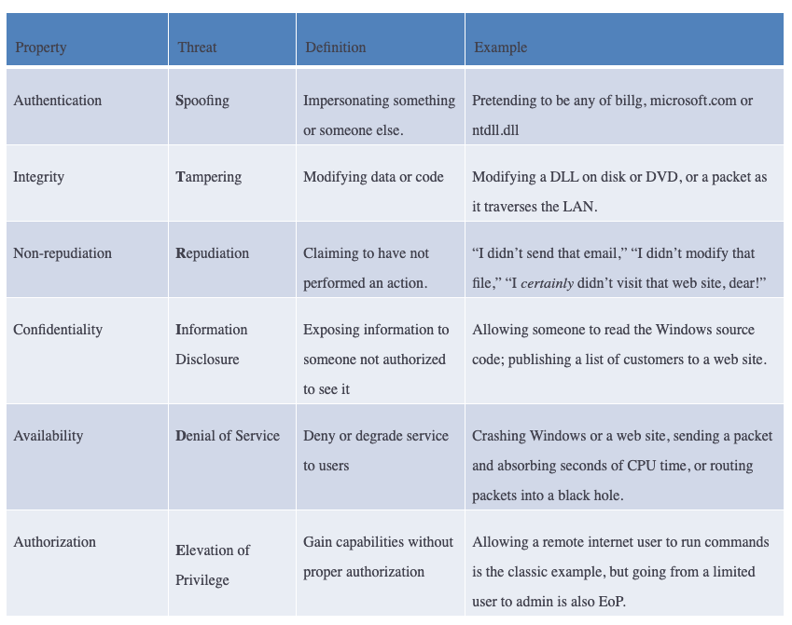
Threat Models
Microsoft STRIDE
https://www.microsoft.com/en-us/securityengineering/sdl/threatmodeling

Slide 64
Fundamental Security Design Principles
Economy of mechanism
Fail-safe defaults
Complete mediation
Open design
Separation of privilege
Least privilege
Least common mechanism
Psychological acceptability
Isolation
Encapsulation
Modularity
Layering
Least astonishment
Despite years of research and development, it has not been possible to develop security design and implementation techniques that systematically exclude security flaws and prevent all unauthorized actions
In the absence of such foolproof techniques, it is useful to have a set of widely agreed design principles that can guide the development of protection mechanisms [NSA/DHS Proposed]

Slide 65
Security Design Principles
Economy of mechanism
Design of security measures embodied in both hardware and software should be as simple and small as possible
The motivation for this principle is that - small design is easier to test and verify thoroughly; complexity complicates management
Fail-safe defaults
Access decisions should be based on permission rather than exclusion
Default situation is lack of access, and the protection scheme identifies conditions under which access is permitted
Complete mediation
Every access must be checked against the access control mechanism
Systems should not rely on access decisions retrieved from a cache
Open design
Design of a security mechanism should be open rather than secret
For example, although encryption keys must be secret, encryption algorithms should be open to public scrutiny

Slide 66
Security Design Principles (2)
Separation of privilege
A practice in which multiple privilege attributes are required to achieve access to a restricted resource
E.g., multifactor user authentication, which requires a password and a smart device, to authorize a user
Least privilege
Every process and every user of the system should operate using the least set of privileges necessary to perform the task
E.g., use of this principle can be seen in role-based access control
Least common mechanism
Design should minimize the functions shared by different users, providing mutual security
This principle helps reduce the number of unintended communication paths
Psychological acceptability
Security mechanisms should not interfere unduly with the work of users, while at the same time meeting the needs of those who authorize access
If security mechanisms hinder the usability or accessibility of resources, users may opt to turn off those mechanisms

Slide 67
Security Design Principles (3)
Isolation
Public access systems should be isolated from critical resources (data, processes, etc.) to prevent disclosure or tampering
In cases where the sensitivity or criticality of the information is high, limit the number of systems on which that data are stored
Encapsulation
A specific form of isolation based on object-oriented functionality
Protection by encapsulating a collection of procedures and data objects so that they may be called only at designated domain entry points
Modularity
Development of security functions as separate, protected modules and use of a modular architecture for mechanism design and practice
Layering
Use of multiple, overlapping protection approaches addressing the people, technology, and operational aspects of information systems
Least astonishment
A program or user interface should always respond in the way that is least likely to astonish the user
For example, the mechanism for authorization should be transparent enough to a user that the user has a good intuitive understanding of the security goals

Slide 68
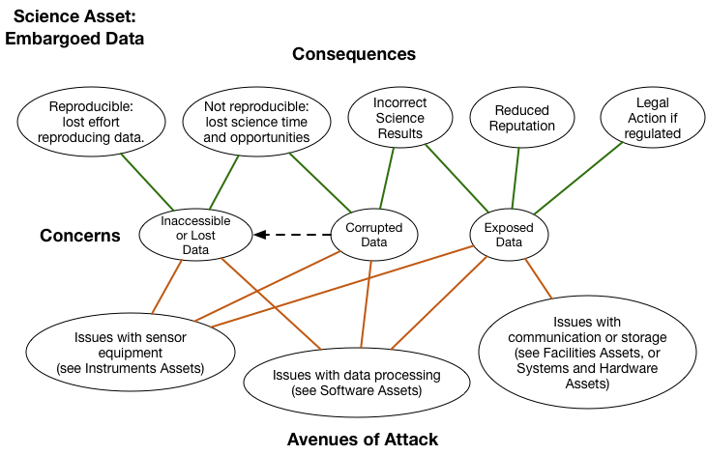
Open Science is also vulnerable to cyber attacks!
Open Science Cyber Risk Profile - http://trustedci.github.io/OSCRP/OSCRP.html

Slide 69
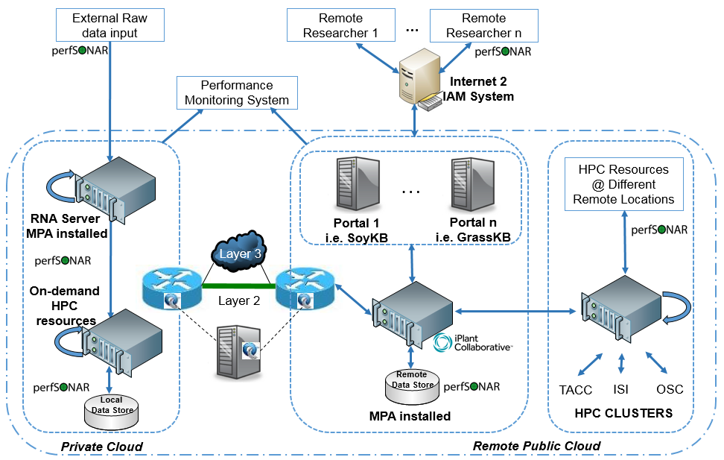
Threat Model Example – Bioinformatics Workflow
SoyKB: Distributed Computing
Notes:
At the data-level, we have noted that a more common concern for users relates to the data access levels (i.e., Loss of Confidentiality) for data-in-motion/data-at-rest/data-in-use within the various lifecycle stages. There is concern of unintended users having access to data due to overprovisioning of privileges amongst the various roles (e.g., KB administrator, domain scientist, data consumer). There is also concern on the ability of strangers to make data copies prior to formal publication of manuscripts, which then may reduce the ‘value’ of the data (considering data is treated as a currency in today’s science communities). Domain scientists are also worried about data integrity issues (i.e., Loss of Integrity) when data leaves their institu- tional boundary and infrastructure is beyond their direct control. There are known cases where data may be corrupted due to administrator error in handling databases, or if a user action causes disk space to exceed for an analysis process. There are always the chances of threats due to malicious attackers who may seek to deliberately compromise data integrity to tarnish a scientist’s reputation, or to make social statements on sensitive debate topics in our society (e.g, in context of healthcare, finance or climate change results). Lastly, there is a threat of users not being able to access their data when needed (i.e., Loss of Availability) due to e.g., administrator error involving inadvertent system management actions which cause major changes to storage that may not get notified to users in a timely manner, which may then result in partial or full loss of their data. At a meta-level, we also seek to study threat models for above issues in the context of a ‘data safety’ assessment that is personalized to the users depending on their lifecycle security requirements.

Slide 70
Network and application layers – security concepts
Packet sniffing and spoofing
Intrusion detection systems
Legal and ethical issues
Module 1

Slide 71
Classes of Intruders – Cyber Criminals
Hackers/Crackers: Individuals or members of an organized crime group with a goal of financial reward
Verizon found that 92% of the breaches they investigated were by outsiders, with 14% by insiders, and with some breaches involving both outsiders and insiders
Insiders were responsible for a small number of very large dataset compromises
Their activities may include:
Identity theft
Theft of financial credentials
Corporate espionage
Data theft
Data ransoming
Typically they are young, often Eastern European, Russian, or southeast Asian hackers, who do business on the Web
They meet in underground forums (e.g., DarkMarket.org and theftservices.com) to trade tips and data and coordinate attacks

Slide 72


Classes of Intruders – Activists
Are either individuals, usually working as insiders, or members of a larger group of outsider attackers, who are motivated by social or political causes
Aim of their attacks is often to promote and publicize their cause typically through:
Website defacement
Denial of service attacks
Theft and distribution of data that results in negative publicity or compromise of their targets (e.g., Edward Snowden, Chelsea Manning)
Also know as Hacktivists - Skill level is often quite low sometimes (i.e., script-kiddies) but there are large skilled groups
(e.g., Anonymous Group, LulzSec)

Slide 73
Examples of Intrusion
NIST SP 800-61 (Computer Security Incident Handling Guide) List:
Remote root compromise
Web server defacement
Guessing/cracking passwords
Copying databases containing credit card numbers
Viewing sensitive data without authorization
Running a packet sniffer
Distributing pirated software
Using an unsecured device to access internal network
Impersonating an executive to get information
Using an unattended workstation
…

Slide 74
Intruder Behavior
Target acquisition and information gathering
Initial access
Privilege escalation
Information gathering or system exploit
Maintaining access
Covering tracks
The techniques and behavior patterns of intruders are constantly shifting, to exploit newly discovered weaknesses and to evade detection and countermeasures
E.g., they start with a phishing attack that results in the installation of malware that steals login credentials that eventually results in the compromise of a Point-of-Sale terminal

Slide 75
Definitions
Security Intrusion:
Unauthorized act of bypassing the security mechanisms of a system
Intrusion Detection:
A hardware or software function that gathers and analyzes information from various areas within a computer or a network to identify possible security intrusions
Intrusion Detection Systems (IDSs) / Intrusion Prevention Systems (IPSs):
Designed to aid countering intrusion threats and are reasonably effective against known, less sophisticated attacks (e.g., large-scale email scams)
They may not be effective against the more sophisticated, targeted attacks by some criminal or state-sponsored intruders (e.g., new, zero-day exploits)
They are part of a defense-in-depth strategy that may also include encryption of sensitive information, detailed audit trails, strong authentication and authorization controls, and active management of application and network security

Slide 76
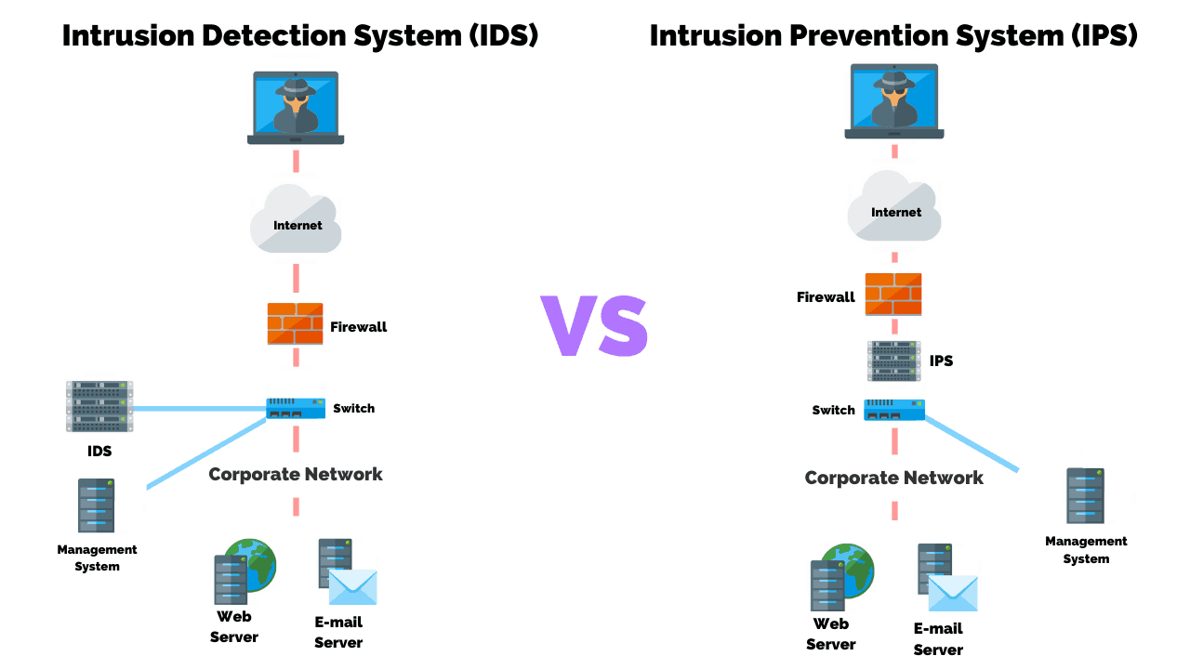
IDS vs IPS

Slide 77
Intrusion Detection System
Host-based IDS (HIDS)
Monitors the characteristics of a single host and its users for suspicious activity
Network-based IDS (NIDS)
Monitors network traffic and analyzes network, transport, and application protocols to identify suspicious activity
Distributed or hybrid IDS
Combines information from a number of sensors, often both host and network based, in a central analyzer and user interface that is able to better identify and respond to intrusion activity
Comprises three logical components:
Sensors – collect data (e.g., network packets, log files, and system call traces)
Analyzers – read sensor data and determine if intrusion has occurred, archive evidence for future analysis, and guide actions
User interface – view output or control system behavior

Slide 78
Analysis Approaches
Signature/Heuristic detection
Anomaly detection
Minimum human supervision
Recover from crashes and reinitializations
Self-monitor and detect intruder modification
Involves the collection of data relating to the behavior of legitimate users over a period of time
Current observed behavior is analyzed to determine whether this behavior is that of a legitimate user or that of an intruder
Can detect unknown, zero-day attacks, as it starts with known good behavior and identifies anomalies to it – but false alarms are common!
Uses a set of known malicious data patterns or attack rules that are compared with current behavior
Also known as misuse detection
Can only identify known attacks for which it has patterns or rules

Slide 79
Anomaly Detection Classification Approaches
Statistical
Analysis of the observed behavior using univariate, multivariate, or time-series models of observed metrics
Knowledge based
Approaches use an expert system that classifies observed behavior according to a set of rules that model legitimate behavior
Machine-learning
Approaches automatically determine a suitable classification model from the training data using data mining techniques
Change-detection principles are used
Difficulty and time consuming to develop a high-quality knowledge from the data, and requires human experts to assist with the process
Training process typically requires lots of sanitized data, and takes significant time and computational resources
Minimum human supervision
Recover from crashes and reinitializations
Self-monitor and detect intruder modification
Two key issues that affect the relative performance of these alternatives are: (i) the efficiency/effectiveness, and (ii) cost of the detection process

Slide 80
Machine Learning Approaches Proposed for an IDS
Bayesian networks: Encode probabilistic relationships among observed metrics
Markov models: Develop a model with sets of states, some possibly hidden, interconnected by transition probabilities
Neural networks: Simulate human brain operation with neurons and synapse between them, that classify observed data
Fuzzy logic: Uses fuzzy set theory where reasoning is approximate, and can accommodate uncertainty
Genetic algorithms: Uses techniques inspired by evolutionary biology, including inheritance, mutation, selection and recombination, to develop classification rules
Clustering and outlier detection: Group the observed data into clusters based on some similarity or distance measure, and then identify subsequent data as either belonging to a cluster or as an outlier
Minimum human supervision
Recover from crashes and reinitializations
Self-monitor and detect intruder modification

Slide 81


Network Security Tools
Wireshark - monitors all information entering and leaving the computer
Snort – highly configurable and portable host-based and network-based IDS; detects intrusions into the system and logs them for further examination on servers & networks
http://www.wireshark.org
http://www.snort.org

Slide 82
Network and application layers – security concepts
Packet sniffing and spoofing
Intrusion detection systems
Legal and ethical issues
Module 1

Slide 83
Cyber Crime and Forensic Evidence
Cybercrime, is a term used broadly to describe criminal activity in which computers or computer networks are a tool, a target, or a place of criminal activity
Forensic Evidence includes anything used in court to prove the validity or falsity of a statement
Cannot be “Hearsay” (E.g. monitor 1 or 2 days and point fingers at attack sources)
Routine monitoring is hence vital
Promotes custody of regular records of cyber activity
Has to present information beyond reasonable doubt

Slide 84
Types of Cyber Crime (as per US Department of Justice categorization)
Computers as targets
Involves an attack on data integrity, system integrity, data confidentiality, privacy, or availability
Computers as storage devices
Using the computer to store stolen password lists, credit card or calling card numbers, proprietary corporate information, pornographic image files, or pirated commercial software
Computers as communications tools
Crimes that are committed online, such as fraud, gambling, child pornography, and the illegal sale of prescription drugs, controlled substances, alcohol, or guns
Minimum human supervision
Recover from crashes and reinitializations
Self-monitor and detect intruder modification

Slide 85
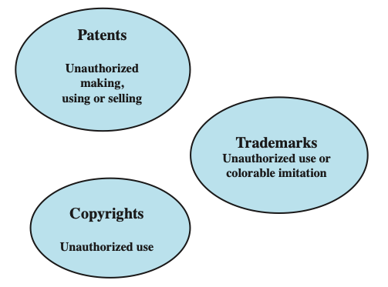
Intellectual Property Infringement
Intellectual property: Any intangible asset that consists of human knowledge and ideas
Examples include software, data, novels, sound recordings, the design of a new type of mousetrap, or a cure for a disease
There are three main types of intellectual property for which legal protection is available:
Copyrights
Trademarks
patents
Minimum human supervision
Recover from crashes and reinitializations
Self-monitor and detect intruder modification

Slide 86
Copyright
Protects tangible or fixed expression of an idea but not the idea itself
Creator can claim and file copyright at a national government copyright office if:
Proposed work is original
Creator has put original idea in concrete form
Minimum human supervision
Recover from crashes and reinitializations

Slide 87
Patent
Grant a property right to the inventor
“The right to exclude others from making, using, offering for sale, or selling” the invention in the United States or “importing” the invention into the United States
An example of a patent from the computer security realm is the RSA public-key cryptosystem; from the time it was granted in 1983 until the patent expired in 2000, the patent holder, RSA Security, was entitled to receive a fee for each implementation of RSA
Types:
Minimum human supervision
Recover from crashes and reinitializations
Utility
Design
Plant
Any new and useful process, machine, article of manufacture, or composition of matter
New, original, and ornamental design for an article of manufacture
Discovers and asexually reproduces any distinct and new variety of plant

Slide 88
Trademark
A word, name, symbol, or device
Used in trade with goods
Indicates source of goods
Distinguishes them from goods of others
Trademark rights may be used to:
Prevent others from using a confusingly similar mark
But not to prevent others from making the same goods or from selling the same goods or services under a clearly different mark
Minimum human supervision

Slide 89
Privacy
Privacy: Assures that individuals control or influence what information related to them may be collected and stored and by whom and to whom that information may be disclosed
Minimum human supervision
Overlaps with computer security
Dramatic increase in scale of information collected and stored
Data-intensive research, Modeling & Simulation, IoT, Social Networks
Motivated by law enforcement, national security, economic incentives
Individuals have become increasingly aware of access and use of personal information and private details about their lives
Concerns about extent of privacy compromise have led to a variety of legal and technical approaches to reinforcing privacy rights

Slide 90
Privacy Protection
Both policy and technical approaches are needed to protect privacy
In terms of technical approaches, the requirements for privacy protection for data stored on information systems can be addresses in part using the technical mechanisms developed for database security
With regard to social media sites, technical controls include:
The provision of suitable privacy settings to manage who can view data on individuals
Notification when one individual is referenced or tagged in another’s content
Although social media sites include some form of these controls, they are constantly changing, causing frustration for users who are trying to keep up with these mechanisms
Another approach for managing privacy concerns in big data analysis is to anonymize the data, removing any personally identifying information before release to researchers or other organizations for analysis
Minimum human supervision

Slide 91
Data Privacy
In terms of policy, guidelines are needed to manage the use and reuse of big data, ensuring suitable constraints are imposed in order to preserve privacy:
Consent
Ensuring participants can make informed decisions about their participation in the research
Privacy and confidentiality
Privacy is the control that individuals have over who can access their personal information
Confidentiality is the principle that only authorized persons should have access to information
Ownership and authorship
Addresses who has responsibility for the data, and at what point does an individual give up their right to control their personal data
Data sharing – assessing the social benefits of research
The social benefits that result from data matching and reuse of data from one source or research project in another
Governance and custodianship
Oversight and implementation of the management, organization, access, and preservation of digital data
Minimum human supervision

Slide 92
Ethical Issues
Ethics: “A system of moral principles that relates to the benefits and harms of particular actions, and to the rightness and wrongness of motives and ends of those actions”
Many potential misuses and abuses of information and electronic communication that create privacy and security problems
Basic ethical principles developed by civilizations apply
Unique considerations surrounding computers and information systems
Scale of activities not possible before
Creation of new types of entities for which no agreed ethical rules have previously been formed
Minimum human supervision

Slide 93
Ethical Hacking
Ethical hackers learn and perform hacking in a professional manner, based on the direction of the client, and later, present a maturity scorecard highlighting their overall risk and vulnerabilities and suggestions to improve
New worms, malware, viruses, and ransomware are multiplying every day and creating a need for ethical hacking services to safeguard the networks of businesses, government agencies or defense
An Ethical Hacker answers the following questions:
What kind of vulnerabilities does an attacker see?
What information or system would a hacker most want access?
What can an attacker do with the information?
How many people notice the attempted hack?
What is the best way to fix the vulnerability?
Minimum human supervision
https://www.eccouncil.org/ethical-hacking/

